Slide 1
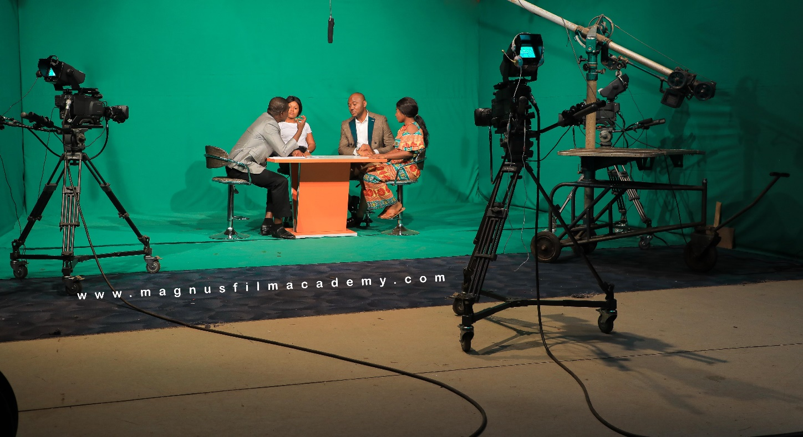
MAGNUS MEDIA NIGERIA
M A G N U S
MEDIA
&
ACADEMY
WE GROOM, WE MENTOR, WE CONNECT
w w w . m a g n u s m e d i a n g . c o m

Slide 2
CONTENTS
01
Who we Are
02
Our Statement
03
What we offer
04
Awards and Testimonials

Slide 3
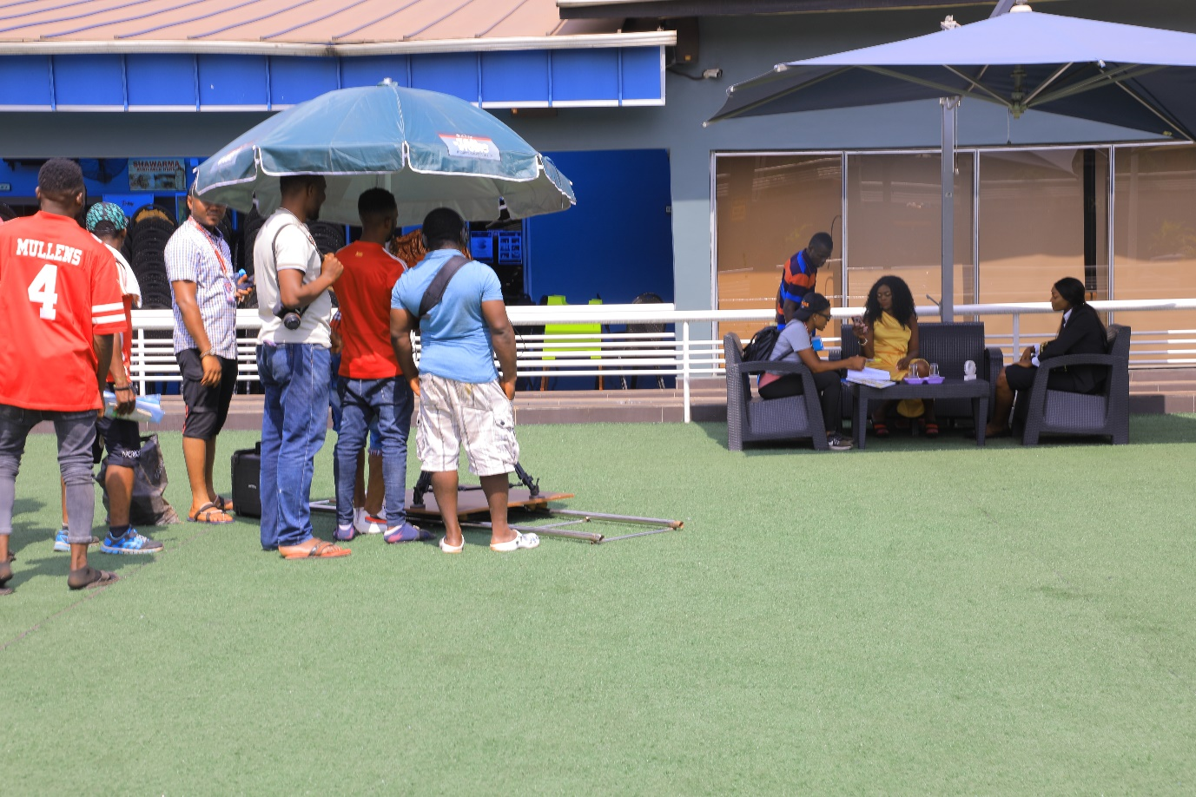
01
WHO WE ARE
Magnus Film Academy (MFA), a subsidiary of Magnus Media Nigeria is a multimedia and film school based in Enugu Sate, Nigeria with over 15 years experience.
MFA is custom built for aspiring media personnel, aspiring filmmakers and creative individuals who are ready and willing to explore the opportunities in the media, multimedia and film industry and become masters in the field under our tutelage.
We are a film institute firmly grounded in all the technical crafts needed to create digital content.
Magnus Film Academy instructors are seasoned industry professionals with international experience

Slide 4
Who we are
Magnus Media Nigeria is a full-service digital content creation and media agency based in Enugu Nigeria. With our wealth of experience , we have worked for clients not only individuals but global brands such as London School of Hygiene and Tropical Medicine, Kaitoma Creatives,
Mix Films Sweden, and Top Nigeria Brands, Governmental and
Nongovernmental organizations such as Emenite Limited, LEAP Africa, ASTOL Group, South Sahara Social Development Organization, Nigeria Tourism Development Corporation, on film making & media training, 3D animation, Outsourcing Crew/Personnel, digital content creation services, event coverage, drone business services, documentaries, artist collaboration, and commercials, LED Mega Screen/Projector, Sound, Lighting and Broadcasting Equipment for Live Streaming of your events.
INSTITUTIONS WORKED FOR
On the areas of Content Creation, trainings on Cinematography and Video editing.
SERVICES RENDERED
We keep memorials alive as we render Services on digital still pictures, entertainment and live streaming.

Slide 5
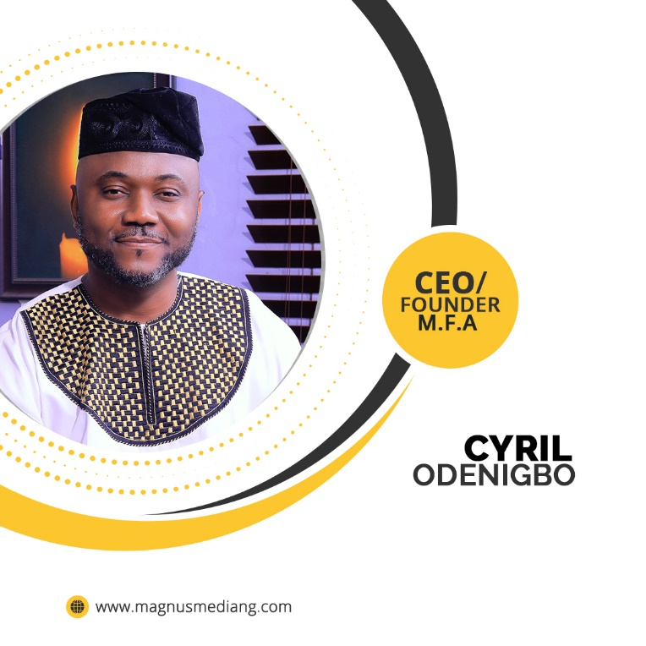
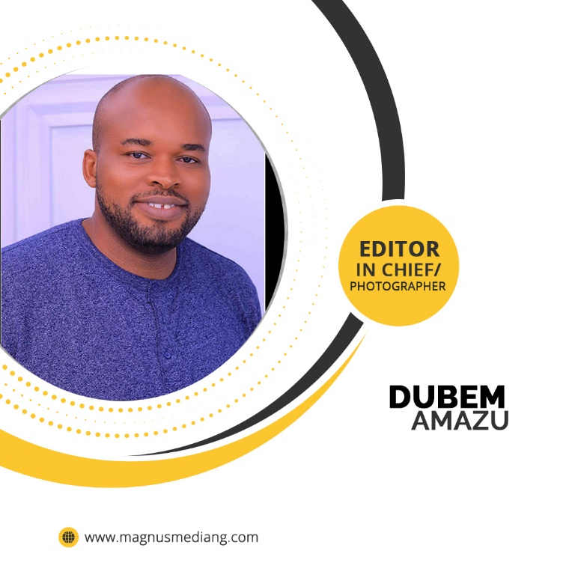
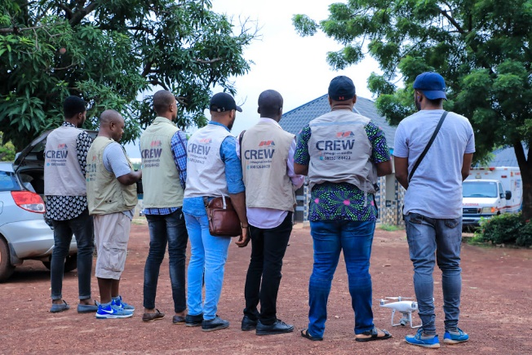
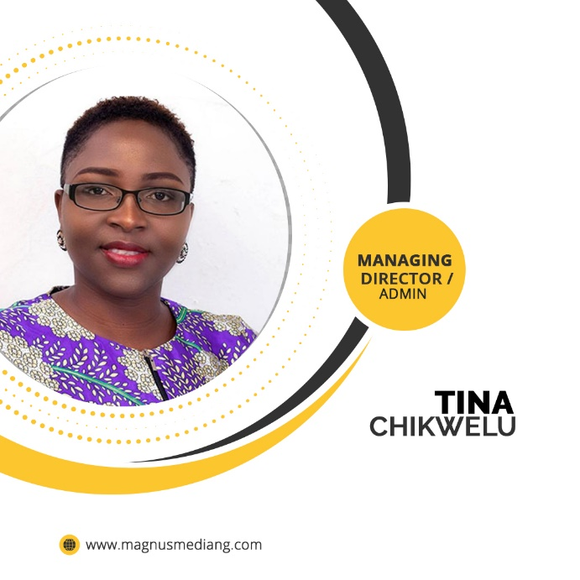
OUR TEAM

Slide 6
Our Clientele
ECONOMIC AND FINANCIAL CRIME COMMISSION NIGERIA (EFCC)
LONDON SCHOOL OF HYGIENE AND TROPICAL MEDICINE
NIGERIA TOURISM DEVELOPMENT CORPORATION
EMENITE GROUP
LEAP AFRICA
Handled a Documentary Project for London School & Tropical Medicine
Interview/ Documentary on their 60th Anniversary as a company
Event Live Streaming Services (Online & Offline) , Lighting and Stage.
Filming & Event Live Streaming Services (Online & Offline) and Sound
Trained the Media Department of Economic & Financial Crimes Commission

Slide 7
Our Clientele
WESLEYAN UNIVERSITY USA
MIXFILM PRODUCTION
SWEDEN
SEAMAN AROMATIC
SCHENAPPS
KAI TOMA CREATIVES
SOUTH AFRICA
SOUTH SAHARAN
SOCIAL DEVELPOMENT
ORGANISATION
Documentary on the Growth and Produce of selected companies in South East Nigeria by Prof. Peter Kilby , Prof. of Economics.
Handled a Film Project for MixFilm Production
Sweden. Filmed their African Story.
Provided Personnel for their Brand marketing activations through Astol Group
Documentary and Interview Filming for their client in Nigeria
Live Streaming Event Services for their Exhibition and campaign.

Slide 8
02
OUR STATEMENT
Always Striving for the Best as we Innovate for Excellence

Slide 9
OUR CORE VALUES
Firmness in our good decisions as we ensure huge success and break even at the end
We uphold our strong morals and ethical principles and values in everything we do.
CONSISTENCY
PROFESSIONALISM
INTEGRITY
CREATIVITY
Strict adherence to our work ethics & value as we discharge of our duties skillfully
Out of nothing, we create extra ordinaire output by putting into action our ingenuity prowess.

Slide 10
OUR MISSION & VISION STATEMENT
MISSION
A dedicated platform to groom and connect film and media
enthusiasts both individuals or team as they learn
the craft and become masters in the field under
our tutelage while through our satisfactory
quality service delivery we continually set
a standard worthy of emulation.
s
}
+
VISION
Our vision is to become a satisfactory testimony on
every lives that come in contact with us in our trainings
and services by tenaciously upholding our core
values for excellent productivity.

Slide 11
03
WHAT WE OFFER
Going by our real focus on customer satisfaction, you can rely on us for efficient and timely delivery of innovative media works and the fulfillment you would get.
For our Film making and Media Training, we assure you of the very best as you undergo practical training and mentorship under our tutelage.

Slide 12
MAGNUS MEDIA & ACADEMY SERVICES
What we offer
COURSES WE OFFER
OUR MULTIMEDIA SERVICES
ACTING & PRESNTATION
CINEMATOGRAPHY
VIDEO EDITING
DRONE PILOTING
SCREENWRITING
EVENT LIVE STREAMING
FILM MAKING & PRODUCTION
3D ANINMATION & SPECIAL EFFECTS
GRAPHIC DESIGN & DIGITAL MARKETING
DRONE BUSINESS SERVICES
BUSINESS PROMOTION
EVENT COVERAGE AND MEDIA SERVICES
EVENT LIVE STREAMING SERVICES
WEBSITE DESIGN & DEVELOPMENT
ARTIST COLLABORATION & PROMOTION
CONTENT CREATION / ANIMATION (VFX) SERVICES
FILMING, INTERVIEW & DOCUMENTARY PRODUCTION

Slide 13
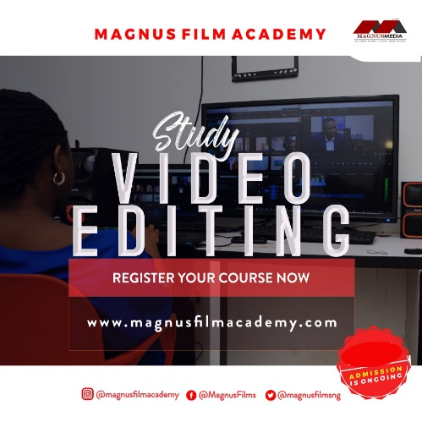
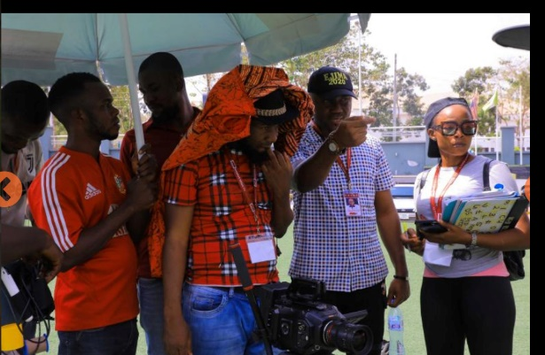
COURSES WE TRAIN ON
SCREENWRITING
COURSE
VIDEO EDITING
COURSE
CINEMATOGRAPHY
COURSE
FILM MAKING AND PRODUCTION
COURSE
DRONE PILOTING
COURSE
Here y
LIVE STREAMING
COURSE
3D ANIMATION/VFX
COURSE
Here y

Slide 14
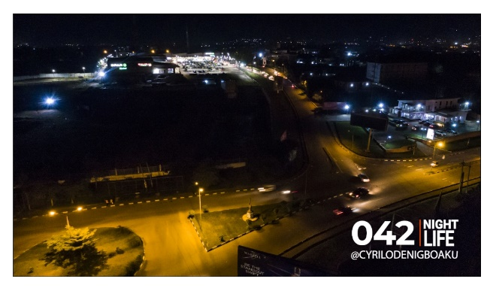
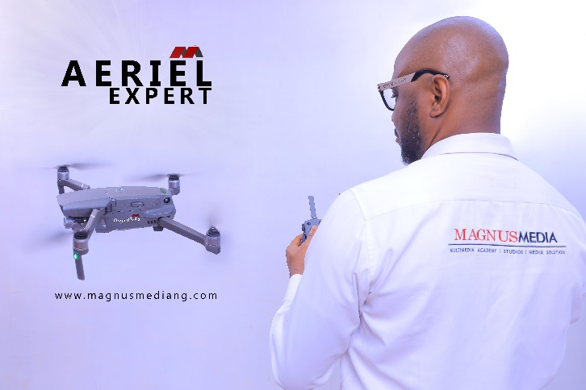
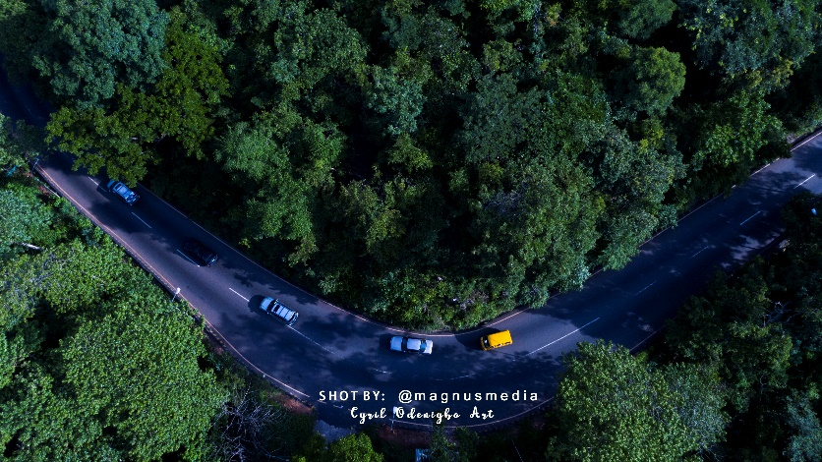
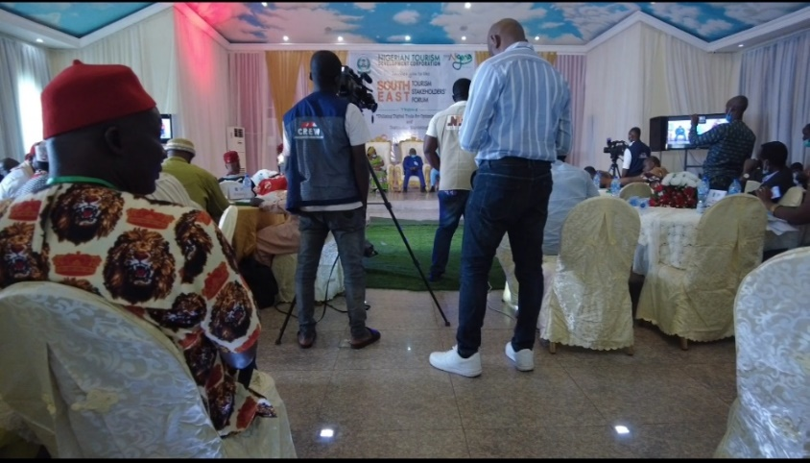
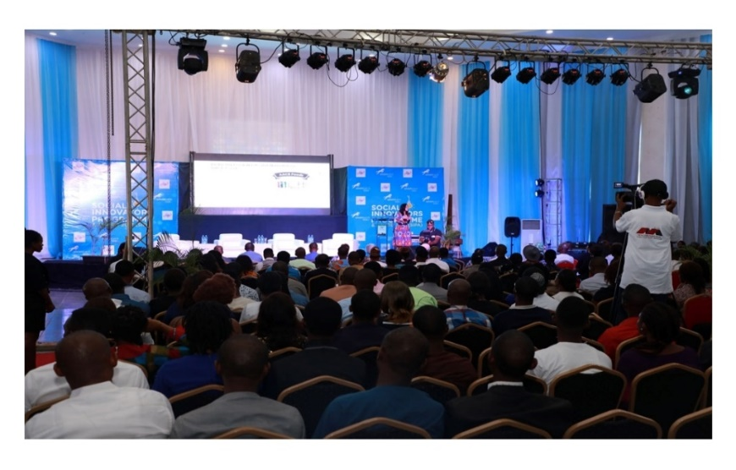
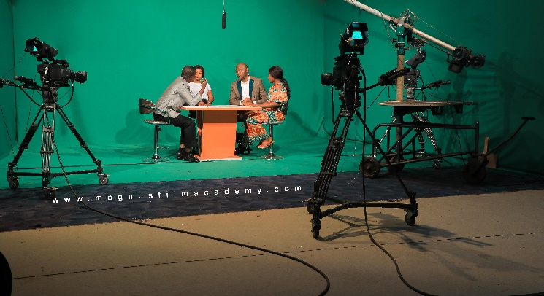
OUR MULITIMEDIA SERVICES
DRONE BUSINESS SERVICES
Aerial Photography & Videography for Real Estate, Events, Inspections, Agricultural Survey, Mapping and Drone Footage for sale
1
EVENT LIVE STREAMING SERVICES
Online and offline video/photo streaming via Zoom, YouTube, Facebook Platforms, LED Mega Screen and projector services
2

Slide 15
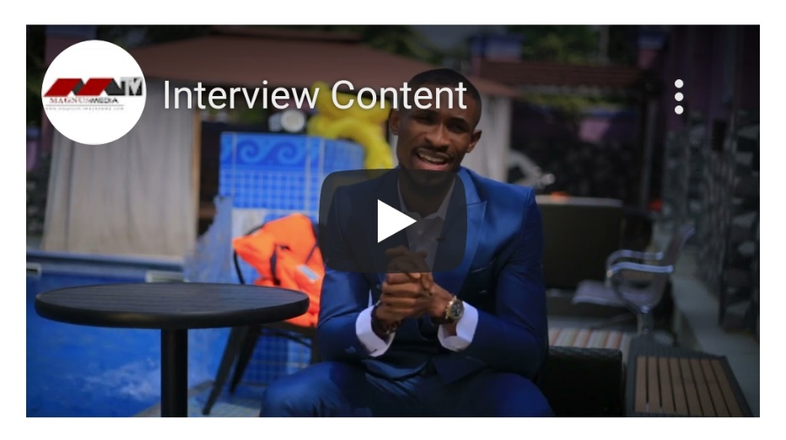
OUR SERVICES
CREW OUTSOURCING AND ARTIST COLLABORATION
Music & Movie Artist collaboration, media production crew, brand artist awareness, models for activations
3
FILMING, MUSIC VIDEO, INTERVIEW & DOCUMENTARY PRODUCTION
4

Slide 16
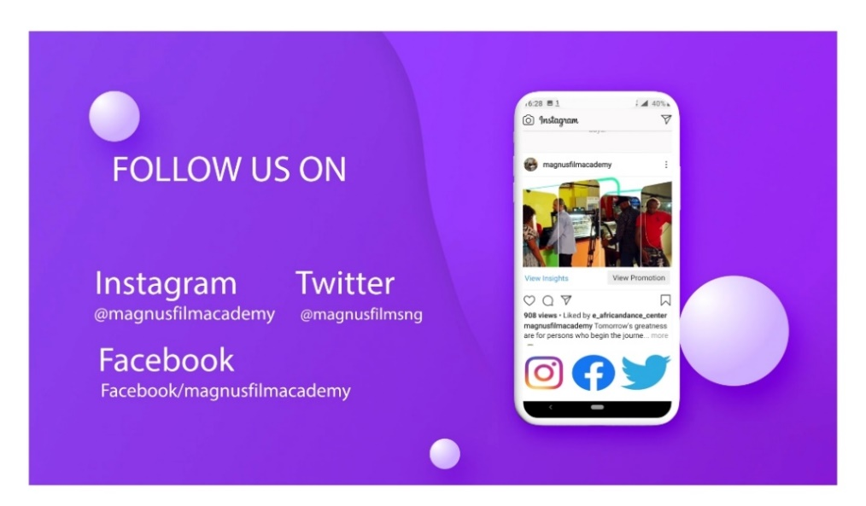
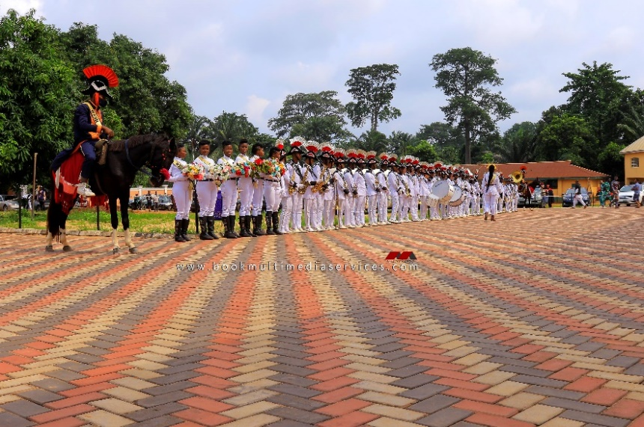
OUR SERVICES
CONTENT CREATION / ANIMATION (VFX) SERVICES
Creative videos for business promotion, 3D animation and VFX, Company Profiling and Product Photoshoot
5
01
02
EVENT COVERAGE AND MEDIA SERVICES
Photography, Videography, Drone, Prewedding, Bridal Shower and the deliverables
03
04
6

Slide 17
OUR BENEFICIARIES
HAVE TRAININED
OVER
2000
OTHER AFRICAN
COUNTRIES
NIGERIA
We have had participants from all works of life within Nigeria and Africa, who attended our hand-on training on multimedia business and filmmaking and also have awarded scholarships to many.
70%
30%
MALE
FEMALE

Slide 18
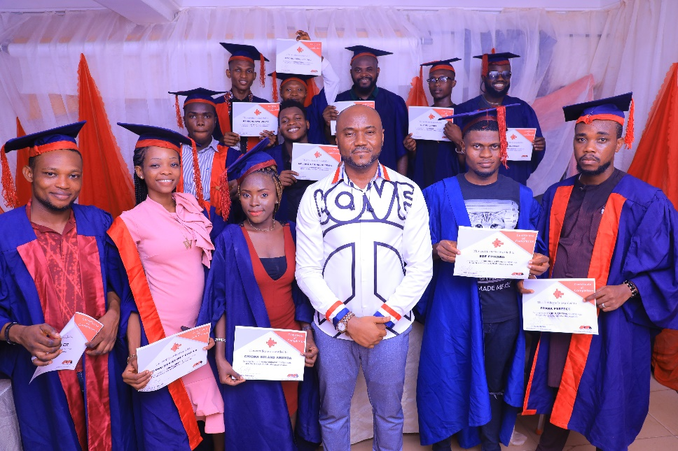
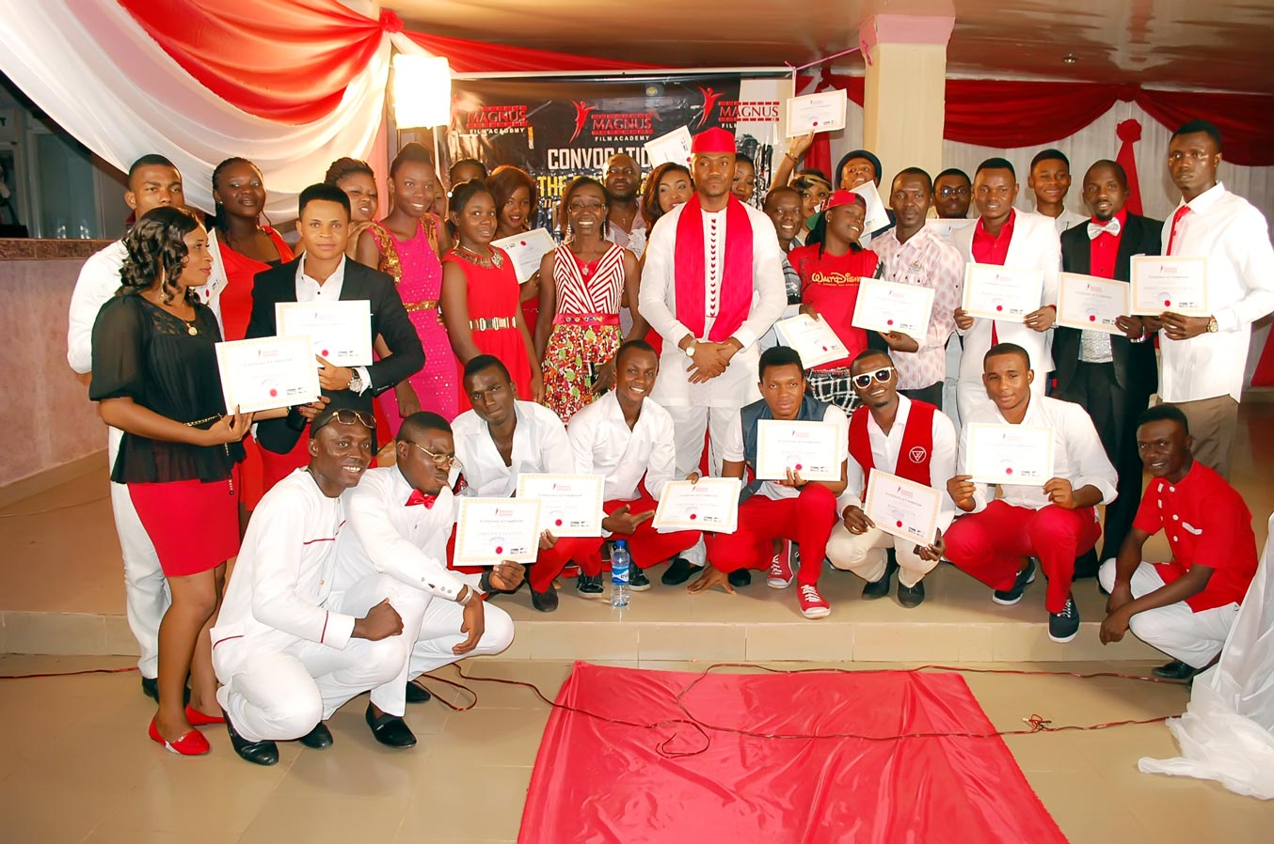
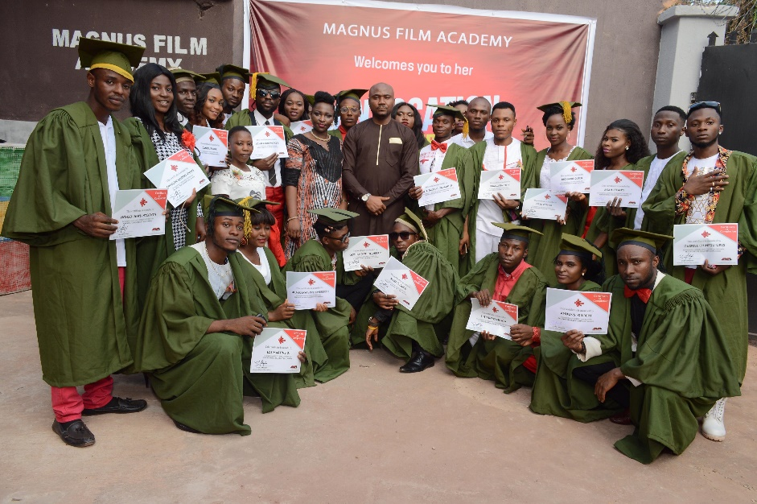
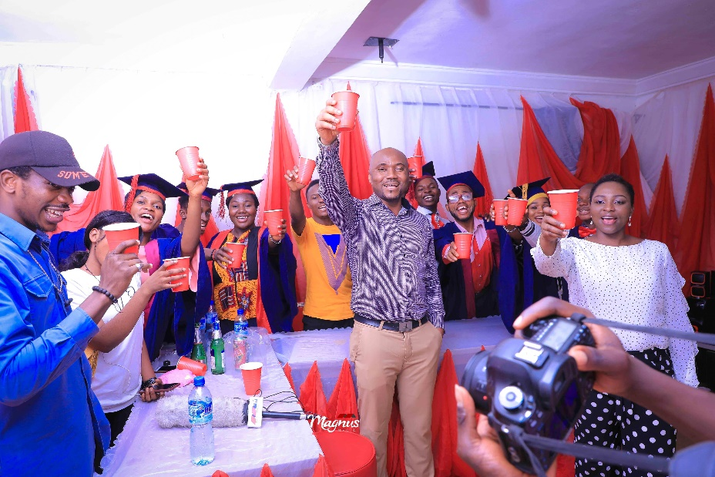
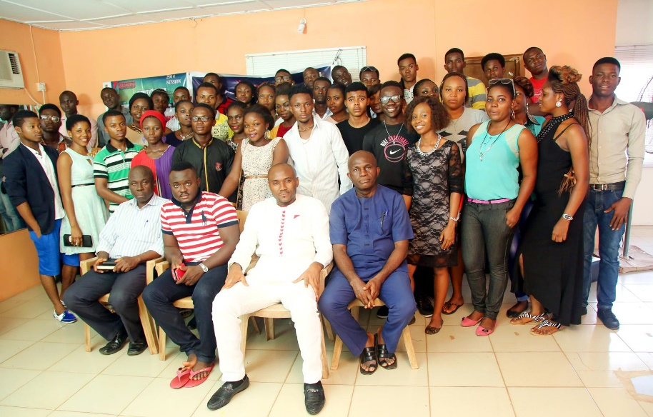
OUR BENEFICIARIES

Slide 19
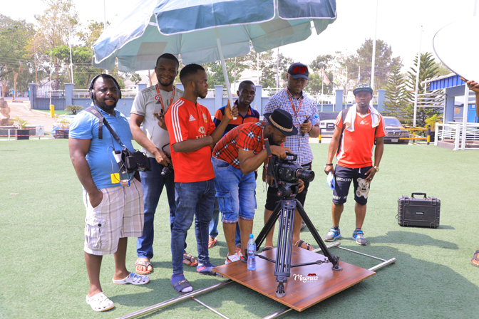
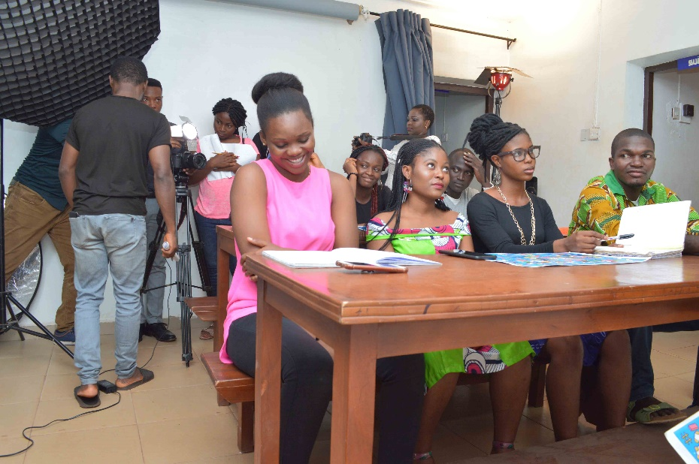
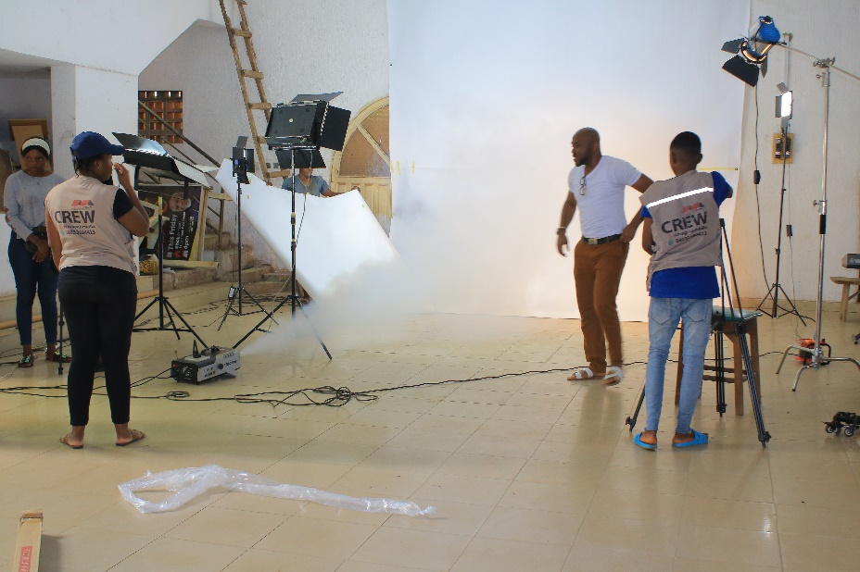
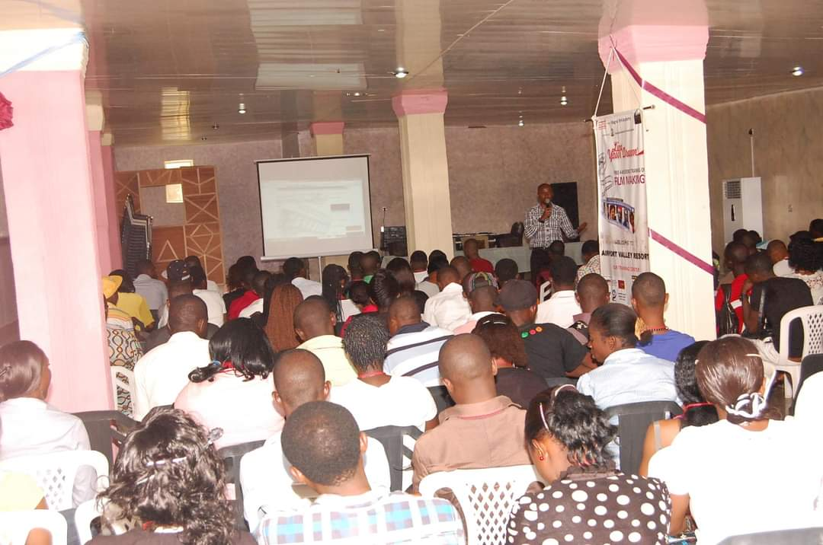
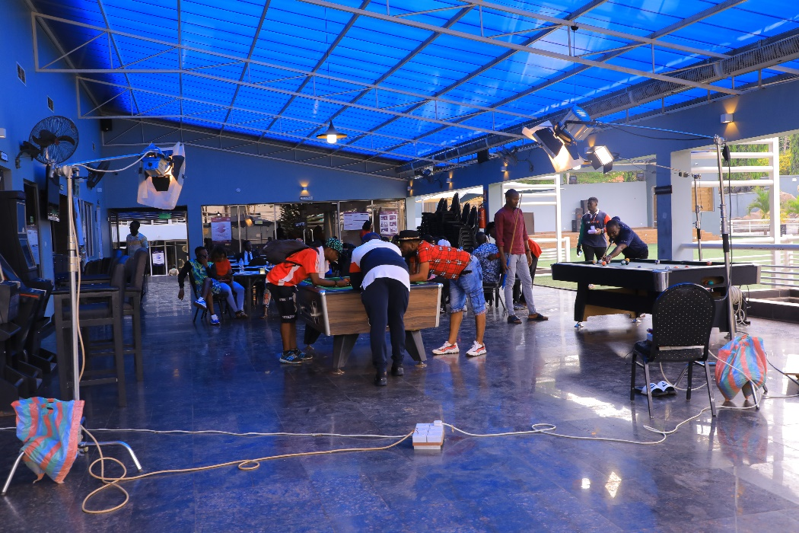
OUR BENEFICIARIES

Slide 20
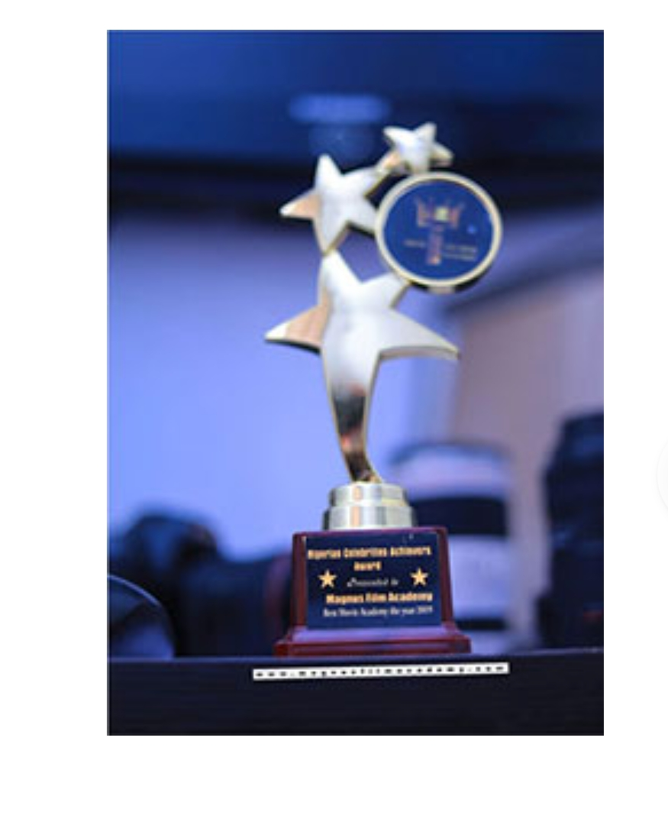
04
AWARDS & TESTIMONIALS
Excellence is the unlimited ability to improve the quality of what you have to offer

Slide 21
AWARDS
BEST FILM ACADEMY
SOUTH EAST NIGERIA 2019
MADE IN NIGERIA AWARDS 2022
WEALBLING CITY AWARDS
Awarded the Best Film Academy
in the South East Nigeria 2019
Award of Recognition for our numerous
contributions in empowering the youth.
Outstanding in Film/TV Production

Slide 22
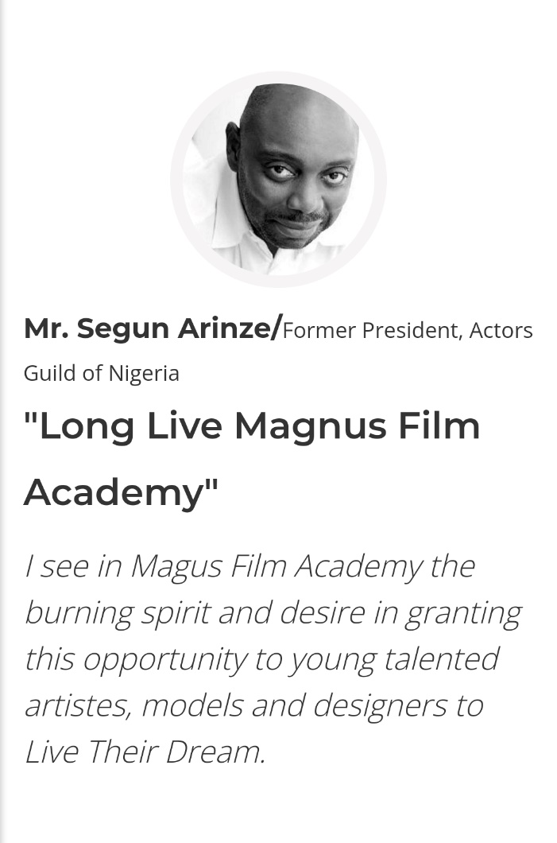
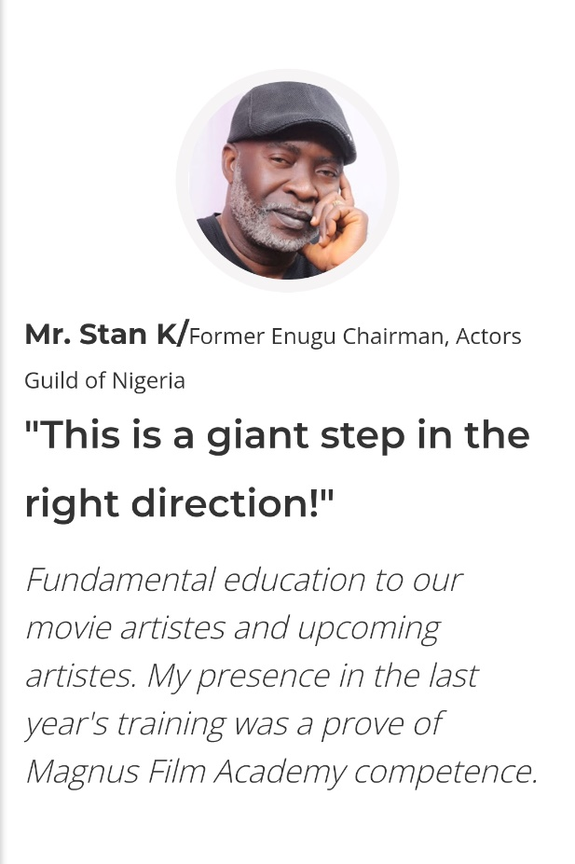
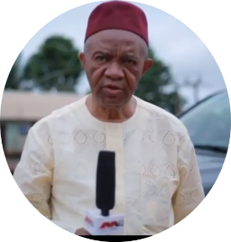
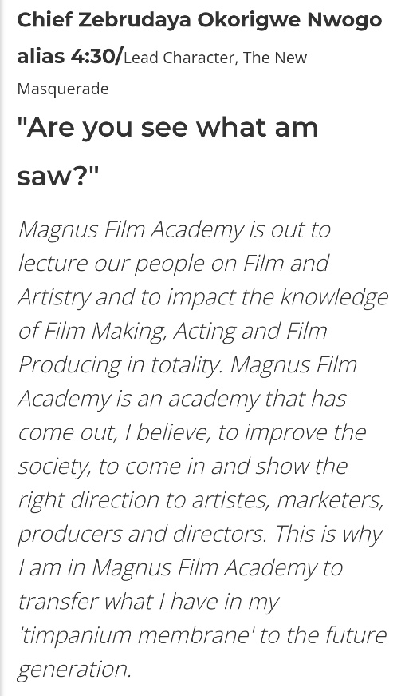
TESTIMONIALS
Mr. Goody Egbuji
General Manager , Projects of Nigerian
National Petroleum Corporation (NNPC)
‘Their documentation of
events very legendary’
We are particularly grateful to Magnus Media for very effective coverage of
our events. They are professional in their attitude and they conduct themselves
very well.
Their documentation of events very legendary.

Slide 23
CONTACT US
+ 2 3 4 8 0 3 2 6 8 4 4 2 3
+ 2 3 4 8 0 3 3 0 7 6 3 0 5
magnusfilms
magnusmediatv
magnusfilmacademy
@magnusmedia
magnusmediang@gmaiI.com
magnusproductionsng@gmail.com
w w w . m a g n u s m e d i a n g . c o m
w w w . m a g n u s f i l m a c a d e m y . c o m

Slide 24
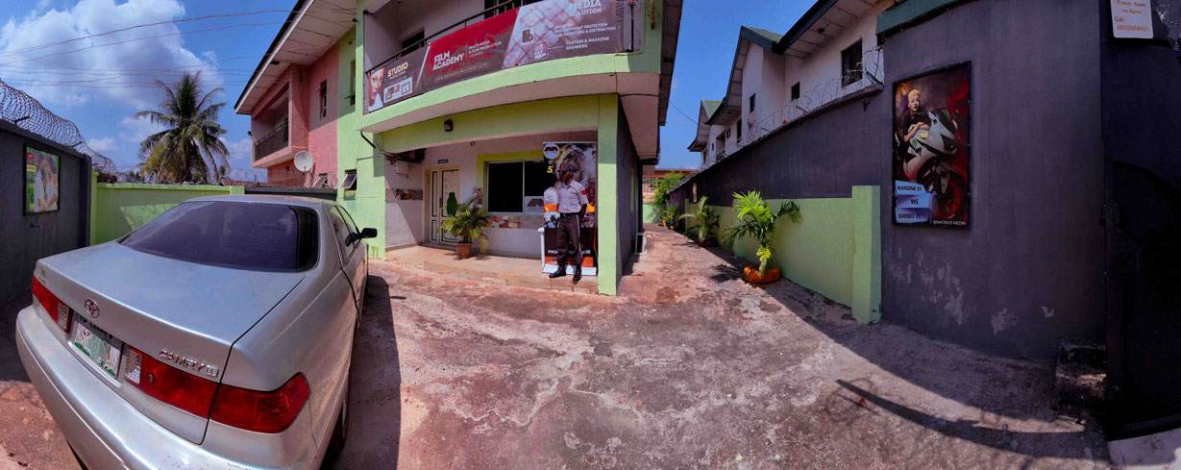
Thank You!
No. 26 First Avenue off Damijah Road Trans Ekulu Enugu Nigeria
w w w . m a g n u s f i l m a c a d e m y . c o m

